Slide 1
SOUND & STAGE
ENTERTAINMENT
BY
KAREEMUNNISA SHAIK

Slide 2
Current system and Its problems
Founded in 1995.
Presently 15 movie theater with counter to buy tickets for upcoming shows.
CEO stated following problems people face while booking tickets-
Long queue to buy tickets
Visit the theater for upcoming movie tickets
Phone lines are busy for enquiry
No news for release of new movies

Slide 3
The Envisioned System
This is an automated system to facilitate online booking.
This online option helps to overcome all drawbacks plus it is scalable.

Slide 4
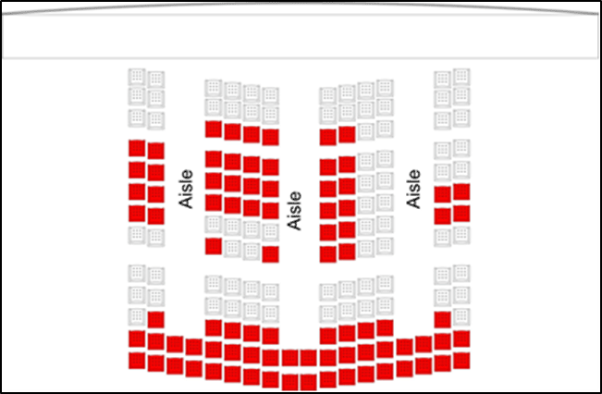

The Seating Arrangement Sample
The Seating Arrangement Sample
The Seating Arrangement Sample
The Seating Arrangement Sample

Slide 5
Components
An Internet-enabled application will be created.
A central repository that will store all information.
An online website that can provide real-time
information about the availability of seats and
enable users to book movie tickets.
A real-time Web-based interface that can be used
for making bookings at the ticket counters.

Slide 6
Features
User will have following facilities-
Select movie, preferred seats and show timings.
Suggested seating pattern based on availability.
Select available seat by clicking on seat.
Select snack and specify the quantity.
After selection proceed to checkout and pay using
credit/debit card.
Unique code is generated after successful
transaction to collect ticket at the time of movie.

Slide 7
System Architecture
This system is designed based on the MVC
design pattern.
MVC design has 3 tier
Presentation tier
Business logic layer tier
Data tier

Slide 8
Presentation Tier

Slide 9
Log On Page
Description :
Allows user to log on to system.
Used only by ticketing counter(POS) officer.
Information available/required
Username : login name of user
Password : login user password
Function available
Logon: launches logon routine and update
relevant session variable.
Exit: closes the web page

Slide 10
Administration page
Sites: Display list of all sites in the system.
Movie Theaters: Displays the list of movie
theater in the system.
Plan layout: Allows create/update/delete of
movie theater plans and final image is
rendered as m x n matrix.
Seat mapping: Allows linking seats to particular
movie theater.
Movies: creation/ updating /deletion of movies
Shows: creating multiple shows for a movie
Snacks: Maintains a master list of the snacks
according to a theater.

Slide 11
Operational Pages
Online Ticket: Allows online booking a ticket for
a movie show.
POS: This page is used to create the Web
interface to be used at a ticketing counter.
Checkout: Handles activities related to
bill payment and payment gateway.
Logs: Displays a log of all the activities
in the system within a specified time
frame. Will be used by administrators
only.

Slide 12
Movies: creation/ updating /deletion of movies
Shows: creating multiple shows for a movie
Snacks: Maintains a master list of the snacks
according to a theater.

Slide 13
THANK YOU

